Slide 1

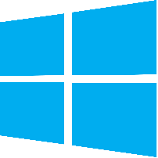


Raymon RTL
Render Right to Left Languages text In Your Projects

Slide 2
planning to target any of these languages?
Arabic
Hebrew
Farsi (Persian)
Yiddish
Kurdish
Urdu
Pashto
העלא
ہیلو
السلام العليک
خوش آمديد
הָלוֹ!
Raymon RTL
http://u3d.as/3kv

Slide 3
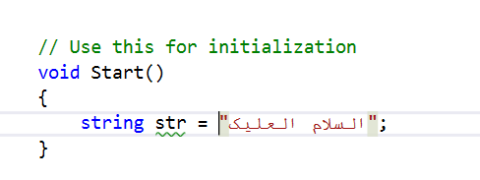
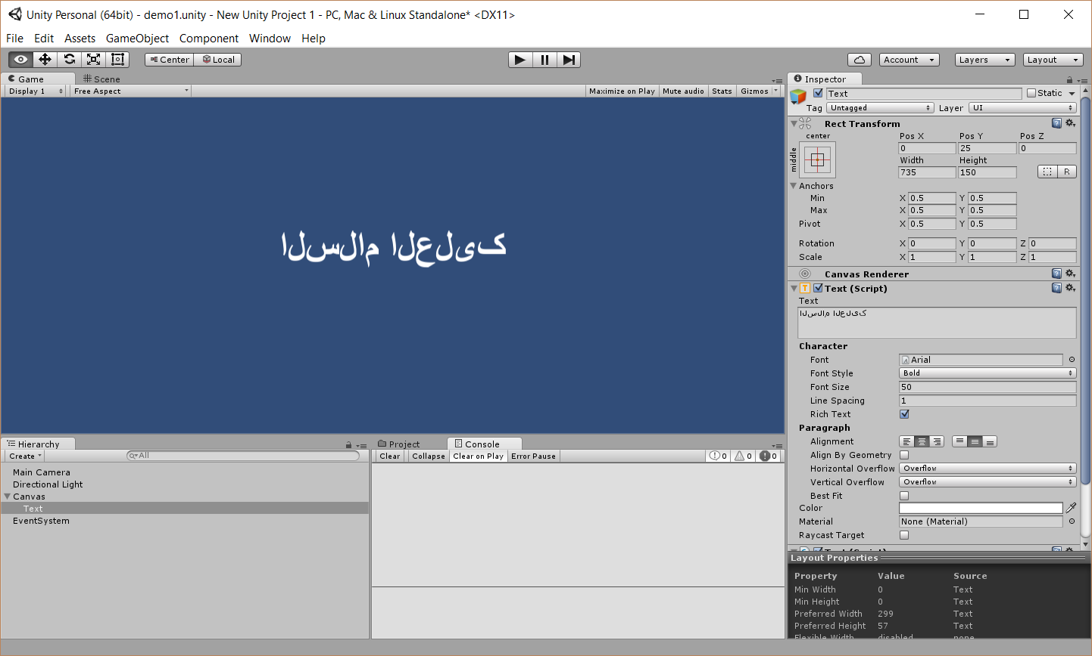
Raymon RTL
Unity3D Does not support?
http://u3d.as/3kv

Slide 4
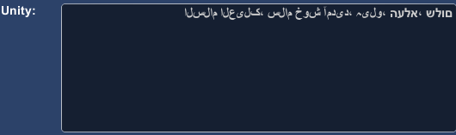
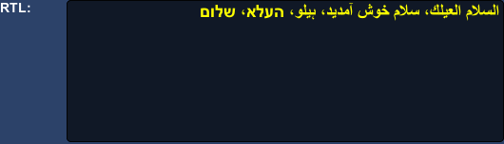
Raymon RTL
Raymon RTL renders correctly
Run-time screen shots from the package on asset store
http://u3d.as/3kv

Slide 5
Easy to use
Single function call
Super fast conversion
Great for huge contents as well
Parameters to control
Adjust number format and wrapping
Use it in all unity versions
Same code in all versions!
Raymon RTL
http://u3d.as/3kv

Slide 6
Top features
multiple language texts conversion at once
Mixed languages is okay!
Arabic/Farsi number formats
1,2,3 or ١,٢,٣
You decide!
combinations of text, Number and Symbols
((متن_کلمه){مشکل}[العربيه] (500))
Math and formula
٢ × (۵ +١) =١٢
Basic word wrapping
Yeah basic right to left word wrapping!
Raymon RTL
http://u3d.as/3kv

Slide 7
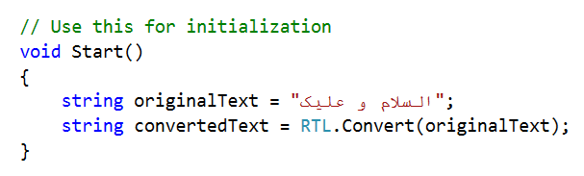
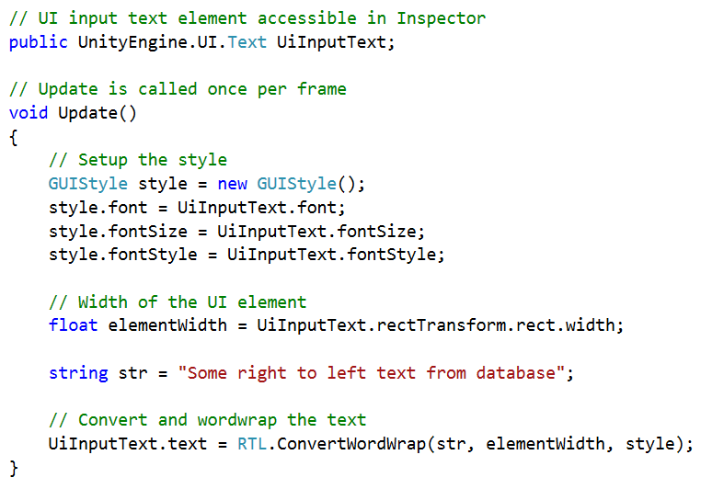
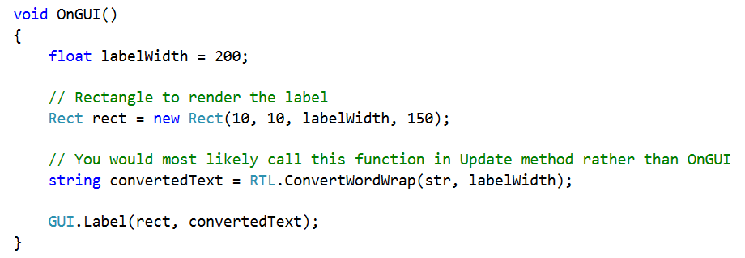
How to use ?
convert text in unity
What about canvas and unity5 elements?
Convert with word-wrap

